Slide 1
Regular Expressions
Chapter 11
Notes:
Note from Chuck. If you are using these materials, you can remove the UM logo and replace it with your own, but please retain the CC-BY logo on the first page as well as retain the acknowledgement page(s) at the end.

Slide 2
Regular Expressions
In computing, a regular expression, also referred to as “regex” or “regexp”, provides a concise and flexible means for matching strings of text, such as particular characters, words, or patterns of characters. A regular expression is written in a formal language that can be interpreted by a regular expression processor.
http://en.wikipedia.org/wiki/Regular_expression

Slide 3
Regular Expressions
Really clever “wild card” expressions for matching and parsing strings
http://en.wikipedia.org/wiki/Regular_expression

Slide 4
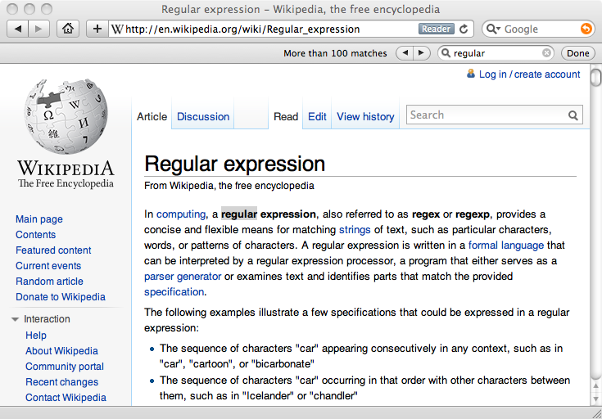
Really smart “Find” or “Search”

Slide 5
Understanding Regular Expressions
Very powerful and quite cryptic
Fun once you understand them
Regular expressions are a language unto themselves
A language of “marker characters” - programming with characters
It is kind of an “old school” language - compact

Slide 6
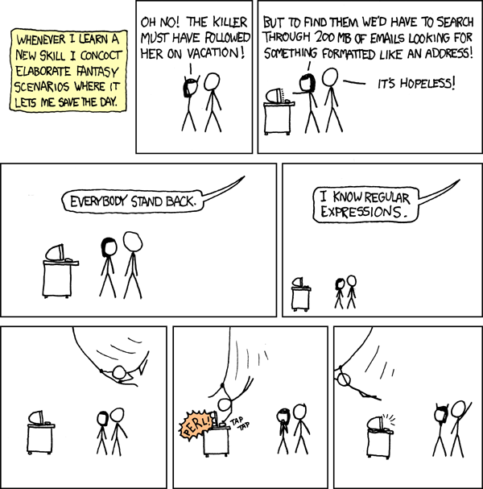
http://xkcd.com/208/

Slide 7
Regular Expression Quick Guide
^ Matches the beginning of a line
$ Matches the end of the line
. Matches any character
\s Matches whitespace
\S Matches any non-whitespace character
* Repeats a character zero or more times
*? Repeats a character zero or more times (non-greedy)
+ Repeats a character one or more times
+? Repeats a character one or more times (non-greedy)
[aeiou] Matches a single character in the listed set
[^XYZ] Matches a single character not in the listed set
[a-z0-9] The set of characters can include a range
( Indicates where string extraction is to start
) Indicates where string extraction is to end

Slide 8
The Regular Expression Module
Before you can use regular expressions in your program, you must import the library using “import re”
You can use re.search() to see if a string matches a regular expression, similar to using the find() method for strings
You can use re.findall() to extract portions of a string that match your regular expression, similar to a combination of find() and slicing: var[5:10]

Slide 9
Using re.search() Like find()
import re
hand = open('mbox-short.txt')
for line in hand:
line = line.rstrip()
if re.search('From:', line) :
print(line)
hand = open('mbox-short.txt')
for line in hand:
line = line.rstrip()
if line.find('From:') >= 0:
print(line)

Slide 10
Using re.search() Like startswith()
import re
hand = open('mbox-short.txt')
for line in hand:
line = line.rstrip()
if re.search('^From:', line) :
print(line)
hand = open('mbox-short.txt')
for line in hand:
line = line.rstrip()
if line.startswith('From:') :
print(line)
We fine-tune what is matched by adding special characters to the string

Slide 11
Wild-Card Characters
The dot character matches any character
If you add the asterisk character, the character is “any number of times”
Many times
Match the start of the line
X-Sieve: CMU Sieve 2.3
X-DSPAM-Result: Innocent
X-DSPAM-Confidence: 0.8475
X-Content-Type-Message-Body: text/plain
^X.*:
Match any character

Slide 12
Fine-Tuning Your Match
Depending on how “clean” your data is and the purpose of your application, you may want to narrow your match down a bit
Many times
Match the start of the line
X-Sieve: CMU Sieve 2.3
X-DSPAM-Result: Innocent
X-Plane is behind schedule: two weeks
X-: Very short
^X.*:
Match any character

Slide 13
Fine-Tuning Your Match
Depending on how “clean” your data is and the purpose of your application, you may want to narrow your match down a bit
X-Sieve: CMU Sieve 2.3
X-DSPAM-Result: Innocent
X-: Very Short
X-Plane is behind schedule: two weeks
One or more times
Match the start of the line
^X-\S+:
Match any non-whitespace character

Slide 14
Matching and Extracting Data
re.search() returns a True/False depending on whether the string matches the regular expression
If we actually want the matching strings to be extracted, we use re.findall()
>>> import re
>>> x = 'My 2 favorite numbers are 19 and 42'
>>> y = re.findall('[0-9]+',x)
>>> print(y)
['2', '19', '42']
[0-9]+
One or more digits

Slide 15
Matching and Extracting Data
When we use re.findall(), it returns a list of zero or more sub-strings that match the regular expression
>>> import re
>>> x = 'My 2 favorite numbers are 19 and 42'
>>> y = re.findall('[0-9]+',x)
>>> print(y)
['2', '19', '42']
>>> y = re.findall('[AEIOU]+',x)
>>> print(y)
[]

Slide 16
Warning: Greedy Matching
The repeat characters (* and +) push outward in both directions (greedy) to match the largest possible string
One or more characters
>>> import re
>>> x = 'From: Using the : character'
>>> y = re.findall('^F.+:', x)
>>> print(y)
['From: Using the :']
^F.+:
First character in the match is an F
Last character in the match is a :
Why not 'From:' ?

Slide 17
Non-Greedy Matching
Not all regular expression repeat codes are greedy! If you add a ? character, the + and * chill out a bit...
One or more characters but not greedy
>>> import re
>>> x = 'From: Using the : character'
>>> y = re.findall('^F.+?:', x)
>>> print(y)
['From:']
^F.+?:
First character in the match is an F
Last character in the match is a :

Slide 18
Fine-Tuning String Extraction
You can refine the match for re.findall() and separately determine which portion of the match is to be extracted by using parentheses
From stephen.marquard@uct.ac.za Sat Jan 5 09:14:16 2008
\S+@\S+
>>> y = re.findall('\S+@\S+',x)
>>> print(y)
['stephen.marquard@uct.ac.za’]
At least one non-whitespace character

Slide 19
Fine-Tuning String Extraction
Parentheses are not part of the match - but they tell where to start and stop what string to extract
From stephen.marquard@uct.ac.za Sat Jan 5 09:14:16 2008
>>> y = re.findall('\S+@\S+',x)
>>> print(y)
['stephen.marquard@uct.ac.za']
>>> y = re.findall('^From (\S+@\S+)',x)
>>> print(y)
['stephen.marquard@uct.ac.za']
^From (\S+@\S+)

Slide 20
String Parsing Examples…

Slide 21
21
31
From stephen.marquard@uct.ac.za Sat Jan 5 09:14:16 2008
>>> data = 'From stephen.marquard@uct.ac.za Sat Jan 5 09:14:16 2008'
>>> atpos = data.find('@')
>>> print(atpos)
21
>>> sppos = data.find(' ',atpos)
>>> print(sppos)
31
>>> host = data[atpos+1 : sppos]
>>> print(host)
uct.ac.za
Extracting a host name - using find and string slicing

Slide 22
The Double Split Pattern
Sometimes we split a line one way, and then grab one of the pieces of the line and split that piece again
From stephen.marquard@uct.ac.za Sat Jan 5 09:14:16 2008
words = line.split()
email = words[1]
pieces = email.split('@')
print(pieces[1])
stephen.marquard@uct.ac.za
['stephen.marquard', 'uct.ac.za']
'uct.ac.za'

Slide 23
The Regex Version
From stephen.marquard@uct.ac.za Sat Jan 5 09:14:16 2008
import re
lin = 'From stephen.marquard@uct.ac.za Sat Jan 5 09:14:16 2008'
y = re.findall('@([^ ]*)',lin)
print(y)
['uct.ac.za']
'@([^ ]*)'
Look through the string until you find an at sign

Slide 24
The Regex Version
From stephen.marquard@uct.ac.za Sat Jan 5 09:14:16 2008
import re
lin = 'From stephen.marquard@uct.ac.za Sat Jan 5 09:14:16 2008'
y = re.findall('@([^ ]*)',lin)
print(y)
['uct.ac.za']
'@([^ ]*)'
Match non-blank character
Match many of them

Slide 25
The Regex Version
From stephen.marquard@uct.ac.za Sat Jan 5 09:14:16 2008
import re
lin = 'From stephen.marquard@uct.ac.za Sat Jan 5 09:14:16 2008'
y = re.findall('@([^ ]*)',lin)
print(y)
['uct.ac.za']
'@([^ ]*)'
Extract the non-blank characters

Slide 26
Even Cooler Regex Version
From stephen.marquard@uct.ac.za Sat Jan 5 09:14:16 2008
import re
lin = 'From stephen.marquard@uct.ac.za Sat Jan 5 09:14:16 2008'
y = re.findall('^From .*@([^ ]*)',lin)
print(y)
['uct.ac.za']
'^From .*@([^ ]*)'
Starting at the beginning of the line, look for the string 'From '

Slide 27
Even Cooler Regex Version
From stephen.marquard@uct.ac.za Sat Jan 5 09:14:16 2008
import re
lin = 'From stephen.marquard@uct.ac.za Sat Jan 5 09:14:16 2008'
y = re.findall('^From .*@([^ ]*)',lin)
print(y)
['uct.ac.za']
'^From .*@([^ ]*)'
Skip a bunch of characters, looking for an at sign

Slide 28
Even Cooler Regex Version
From stephen.marquard@uct.ac.za Sat Jan 5 09:14:16 2008
import re
lin = 'From stephen.marquard@uct.ac.za Sat Jan 5 09:14:16 2008'
y = re.findall('^From .*@([^ ]*)',lin)
print(y)
['uct.ac.za']
'^From .*@([^ ]*)'
Start extracting

Slide 29
Even Cooler Regex Version
From stephen.marquard@uct.ac.za Sat Jan 5 09:14:16 2008
import re
lin = 'From stephen.marquard@uct.ac.za Sat Jan 5 09:14:16 2008'
y = re.findall('^From .*@([^ ]*)',lin)
print(y)
['uct.ac.za']
'^From .*@([^ ]+)'
Match non-blank character
Match many of them

Slide 30
Even Cooler Regex Version
From stephen.marquard@uct.ac.za Sat Jan 5 09:14:16 2008
import re
lin = 'From stephen.marquard@uct.ac.za Sat Jan 5 09:14:16 2008'
y = re.findall('^From .*@([^ ]*)',lin)
print(y)
['uct.ac.za']
'^From .*@([^ ]+)'
Stop extracting

Slide 31
Spam Confidence
import re
hand = open('mbox-short.txt')
numlist = list()
for line in hand:
line = line.rstrip()
stuff = re.findall('^X-DSPAM-Confidence: ([0-9.]+)', line)
if len(stuff) != 1 : continue
num = float(stuff[0])
numlist.append(num)
print('Maximum:', max(numlist))
python ds.py
Maximum: 0.9907
X-DSPAM-Confidence: 0.8475

Slide 32
Escape Character
If you want a special regular expression character to just behave normally (most of the time) you prefix it with '\'
>>> import re
>>> x = 'We just received $10.00 for cookies.'
>>> y = re.findall('\$[0-9.]+',x)
>>> print(y)
['$10.00']
At least one or more
\$[0-9.]+
A real dollar sign
A digit or period

Slide 33
Summary
Regular expressions are a cryptic but powerful language for matching strings and extracting elements from those strings
Regular expressions have special characters that indicate intent

Slide 34
Practice Re
Finding Numbers in a Haystack
In this assignment you will read through and parse a file with text and numbers. You will extract all the numbers in the file and compute the sum of the numbers.
Data Files
We provide two files for this assignment. One is a sample file where we give you the sum for your testing and the other is the actual data you need to process for the assignment.
Sample data: regex_sum_42.txt (There are 90 values with a sum=445833)
Actual data: regex_sum_1484585.txt (There are 67 values and the sum ends with 580)

Slide 35
Practice Re
Handling The Data:
The basic outline of this problem is to read the file, look for integers using the re.findall(), looking for a regular expression of '[0-9]+' and then converting the extracted strings to integers and summing up the integers.

